Slide 1
PHISHING AWARENESS TRAINING
Obective: Educate others about recognizing and avoiding phishing emails,websites, and social engineering tactics
-K.SAI NADH

Slide 2
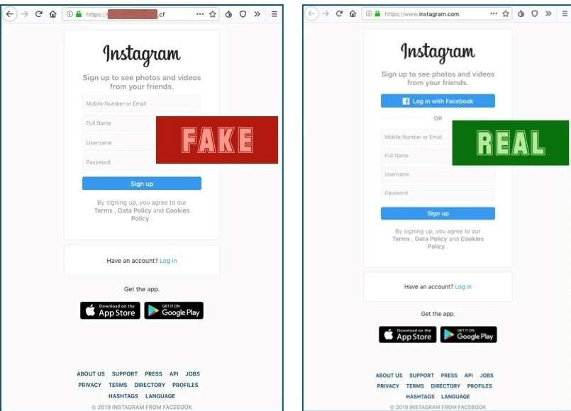
Phishing attack
Phishing attacks are deceptive tactics used by cybercriminals to trick you into revealing sensitive information. They often involve fake emails, websites, or messages that appear legitimate but aim to steal your personal data. Always be cautious and double-check before sharing any sensitive information online!

Slide 3
Types of Phishing attacks:
1. Email phishing: Fake emails trick you into sharing personal information or clicking malicious links.
2. Spear phishing: Targeted emails that appear legitimate to deceive specific individuals or organizations.
3. Smishing: Phishing attacks through SMS or text messages.
4. Vishing: Voice-based phishing, where scammers impersonate trusted entities over the phone.

Slide 4
5. Pharming: Redirecting users to fake websites to collect their sensitive information.
6. Whaling: Phishing attacks targeting high-profile individuals like executives or celebrities.
7. Malware-based phishing: Emails or links that download malware onto your device.
8. Social media phishing: Fake profiles or messages on social media platforms to deceive users.

Slide 5
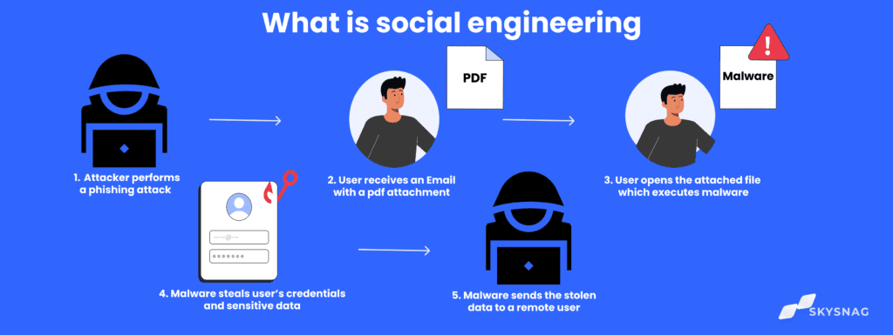
Social engineering :
A social engineering attack is when someone tricks people into revealing sensitive information through manipulation and deception. It's important to stay cautious and skeptical to protect your personal data!

Slide 6
Types of social engineering attacks:
1. Phishing: Deceptive emails or messages tricking you into sharing personal information.
2. Pretexting: Creating a false scenario to gain someone's trust and extract information.
3. Baiting: Offering something enticing to trick people into revealing sensitive data.
4. Tailgating: Unauthorized individuals following someone to gain access to a restricted area.

Slide 7
5. Impersonation: Posing as a trusted person or entity to deceive and manipulate others.
6. Quid pro quo: Offering a benefit in exchange for sensitive information or access.
7. Reverse social engineering: Manipulating someone to believe they need help and revealing information.
8. Water-holing: Infecting websites frequented by a target audience to gain access to their devices.

Slide 8
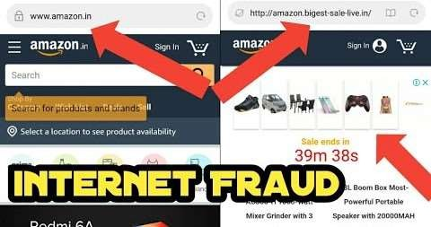
What is website spoofing ?
Website spoofing is the act of creating a website with the malicious intention to mislead the users.
Basically this websites are created by a different person or organization or by a hacker.
Website spoofing is the creation of a replica of a trusted site with the intention of misleading visitors to a phishing site
REAL
FAKE

Slide 9
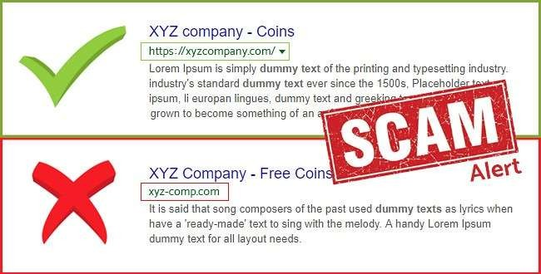
web spoofing leads to
Phishing attack.
Click jacking attack.
Download’s malware.
Data breaches.
Ransomware attack.
Loss of reputation and money.

Slide 10
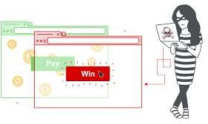
Click jacking attack
Clickjacking is an attack that fools users into thinking they are clicking on one thing when they are actually clicking on another.
Website spoofing can also lead to “click jacking attack”.

Slide 11
How to avoid spoofed websites ?
Don’t click emailed links or attachements
Use bookmarks for frequently visited pages.
Manually search for frequently visited url’s
Use a trusted antivirus program.
Avoid opening unfamilier resources
Don’t access websites which have weak encryption protocols.

Slide 12
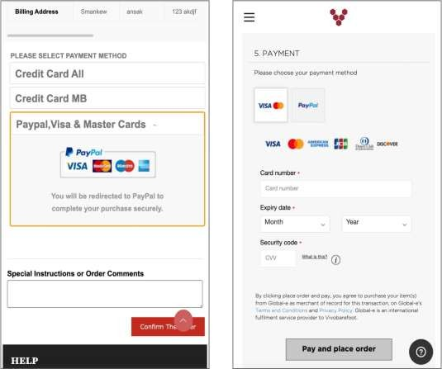
The consequences of web spoofing can cause:
Stealing personal or company information, Credentials, spreading malware and gaining unauthorized network access.
Website spoofing occurs when a scammer copies a brand and there logos, content, product lists, and domain name, in order to mislead users looking for a genuine site.
FAKE
REAL

Slide 13


